Slide 1

AIR AWARE:SMART AIR QUALITY PREDICTION SYSTEM
Presented by: Ruchitha Mallela, Rahul Kummara
Team:4
INFOSYS Batch:6
Mentor:Shakthi

Slide 2
Contents
Introduction
Understanding AQI
Impacts of air pollution on health
Objective
System architecture
Project implementation
Progress journey of all milestones
Output snippets &conclusion

Slide 3
Introduction
Air Aware is an intelligent air quality monitoring and forecasting platform designed to provide timely insights into environmental health.
The project leverages real-time pollutant data, advanced machine learning techniques, and a user-friendly dashboard to help users understand current air conditions and predict future AQI trends.
By focusing on nationwide monitoring across India, Air Aware empowers the public with awareness and supports better decision-making for health and safety.
Through its interactive interface and accurate Random Forest–based prediction model, the system aims to promote environmental consciousness and contribute to building cleaner, healthier communities.

Slide 4
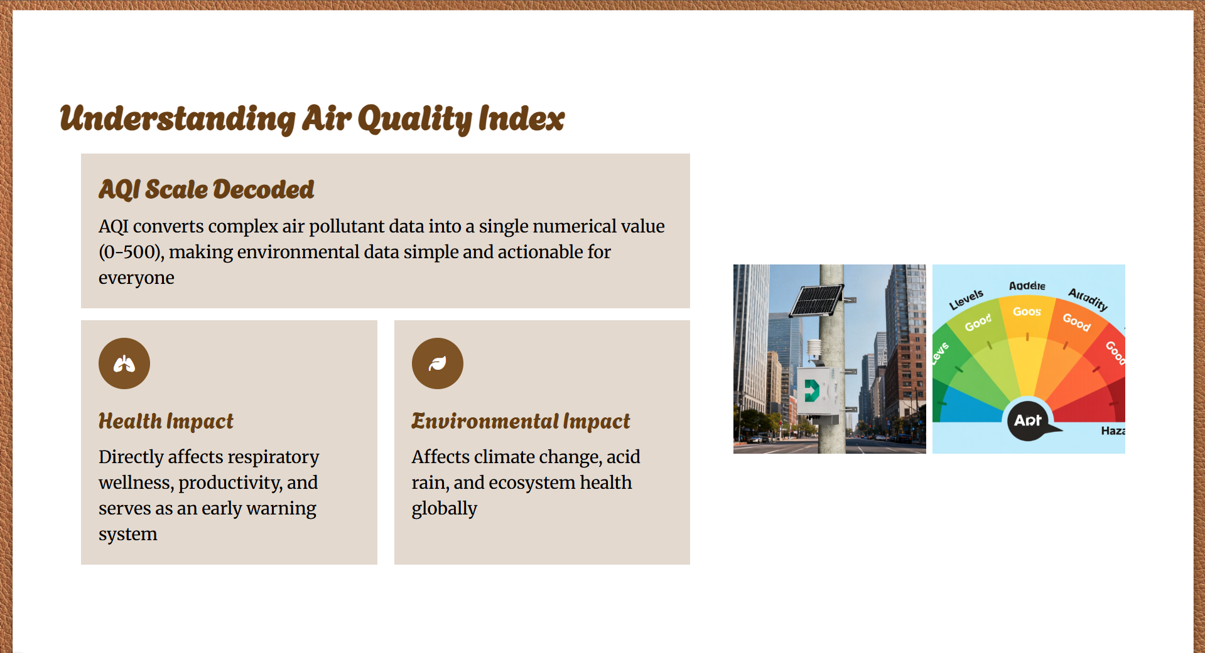

Slide 5
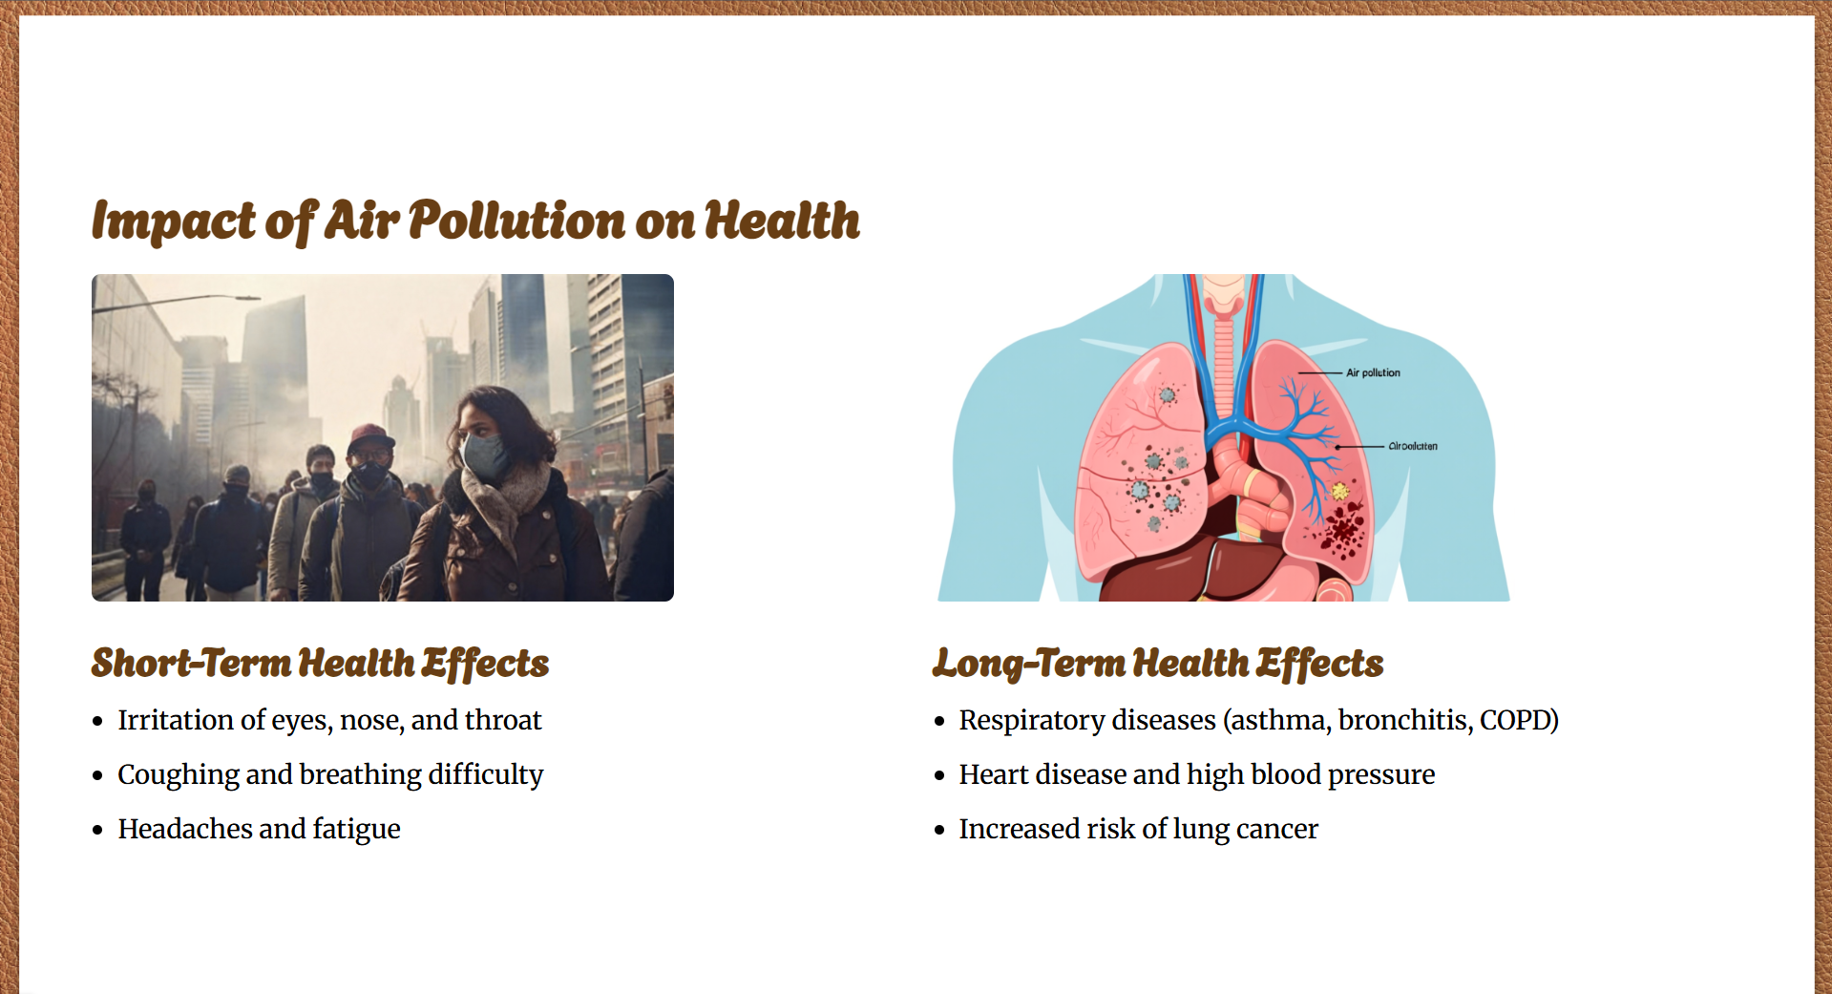

Slide 6
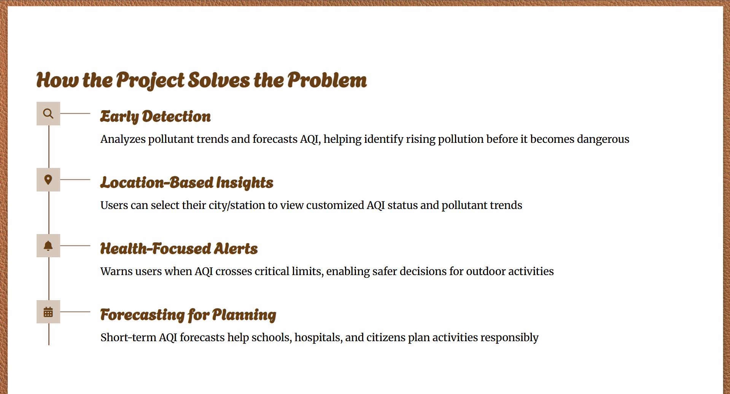

Slide 7
Objective
To fetch real-time AQI data using reliable external APIs.
To predict future AQI using machine learning models.
To provide health recommendations based on AQI levels.
To support multiple Indian cities.
To implement secure user authentication

Slide 8
System architecture
Frontend: React.js dashboard for visualization.
Backend: Flask REST APIs for data processing.
Database: MongoDB for storing users and AQI data.
External API: OpenWeather Air Pollution API.
Machine Learning: Random Forest Regressor for AQI prediction.
(Frontend → Backend → API/ML → Database → Frontend)

Slide 9
Frontend and Backend Implementation
The frontend of the Smart AQI Prediction System was developed using React.js to create a dynamic, component-based, and responsive user interface.
Tailwind CSS was used to design an attractive, colorful, and professional dashboard with support for light and dark modes.
The dashboard provides real-time AQI visualization, pollutant-level charts, and AQI prediction graphs for different time scales (hourly, daily, and monthly).
Users can select locations across India, view location-based AQI data, receive health recommendations, and get alert notifications.
Additional features such as dashboard sharing (PDF/social media) and interactive UI components enhance usability and user experience.
Built RESTful APIs using Flask.
Integrated OpenWeather AQI
Implemented modular backend structure:
  Routes
  Services
  Models
  Utilities
Enabled JWT-based authentication.
Handled error management and API validation

Slide 10
Machine Learning Model
Dataset collected from Kaggle (Indian AQI Dataset).
Features used:
  PM2.5, PM10, CO, NO₂, SO₂, O₃
Data preprocessing:
  Missing value handling
Feature normalization
  AQI calculation
Model used:
  Random Forest Regressor – Achieved 99.9% Accuracy
Outputs:
  Hourly, weekly, and monthly AQI predictions

Slide 11
Authentication and Database
User registration and login implemented using Flask.
Passwords encrypted using bcrypt hashing.
Session management using JWT tokens.
MongoDB stores: User credentials,AQI records
Ensured secure and reliable data storage

Slide 12
Technology Stack & Development Tools
Frontend: React.js and Tailwind CSS for building a modern, responsive, and interactive user interface
Backend: Flask (Python) for handling APIs, authentication, and model integration
Machine Learning: Random Forest model implemented using scikit-learn for accurate AQI prediction
Database: MongoDB for storing user data and air-quality records
Development Tools: VS Code, GitHub for version control, Postman for API testing, and Node.js for frontend dependency management

Slide 13
Progress Journey Across All Milestones
Milestone 1 – Initial Setup
Defined project concept & architecture
Built initial frontend (Home & basic dashboard)
Set up project repository & folder structure
Created initial UI components for dashboard
Milestone 2 – Feature Enhancement
Upgraded alert system from SMS to Email, WhatsApp & Twitter
Trained ML model for accurate AQI predictions
Enhanced dashboard interactivity
Milestone 3 – Backend Integration
Prepared dataset & backend setup
Configured MongoDB
Connected frontend with backend APIs
Enabled user authentication & profile management
Deployed predictions & health recommendations
Milestone 4 – Final Touches & Testing
Added About & Profile sections
Conducted testing & fixed errors
Improved security & prepared final report/presentation

Slide 14
Team Contribution
Ruchitha Mallela
The frontend development of the Smart AQI Monitoring and Prediction System was entirely handled by me and Iam responsible for designing and implementing the complete user interface using React.js. This included building responsive pages, integrating dynamic dashboards, visualizing AQI and pollutant data through charts, implementing city selection, theme toggling, and ensuring a smooth and user-friendly experience across the application. Additional sections like About, Profile, and health recommendation cards help users understand air quality impacts and system functionality.
Rahul Kummara
The backend development was independently designed and implemented by rahul, covering end-to-end server-side functionality. And his contribution included developing RESTful APIs using Flask, integrating real-time AQI data from external APIs, implementing secure user authentication with JWT and password hashing, designing MongoDB database interactions, training and deploying a machine learning model for AQI prediction, and ensuring seamless communication between the frontend and backend.

Slide 15


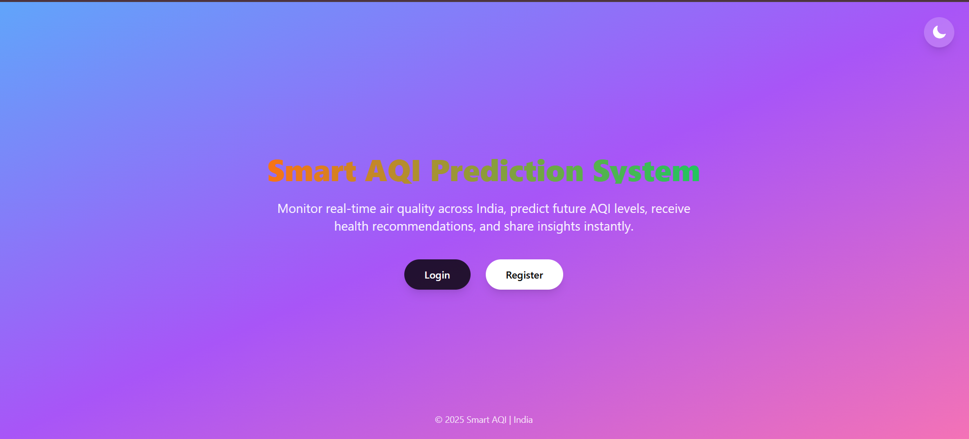
Output Snippets
Fig 1: Home Page
Fig 2: Login Page
Fig 3:Register Page

Slide 16
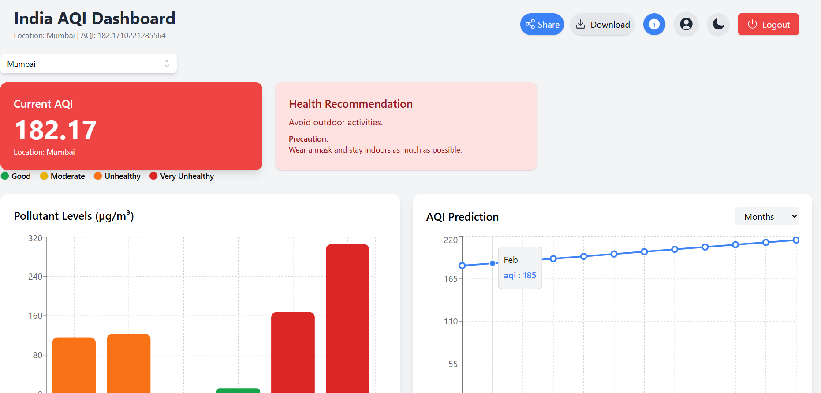
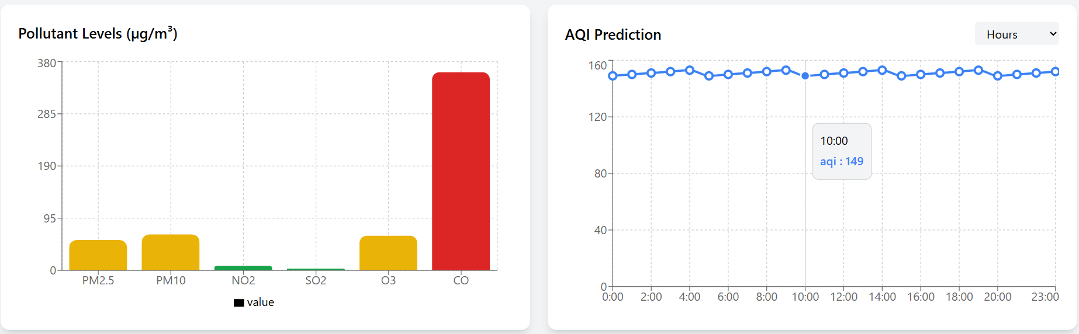
Fig 4: Dashboard
Fig 5: Graphs

Slide 17
Conclusion
The Smart AQI Prediction System successfully delivers a complete full-stack solution by integrating real-time air quality data, machine learning-based AQI prediction, and secure user authentication into a single platform. The system provides accurate current AQI values, pollutant-level insights, and future AQI trends across multiple Indian cities, enabling users to better understand air pollution conditions. By combining data visualization, health-based recommendations, and secure access, the application empowers users to take informed preventive measures, thereby contributing to improved public health awareness and environmental sustainability.

Slide 18
THANK YOU
Questions & Discussions Welcome

